Slide 1
Pre-Live Session
Model Identification for Stationary Model

Slide 2
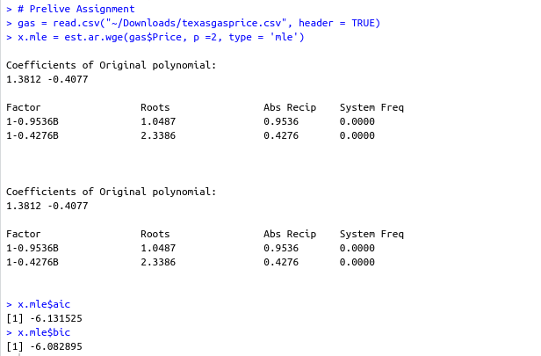
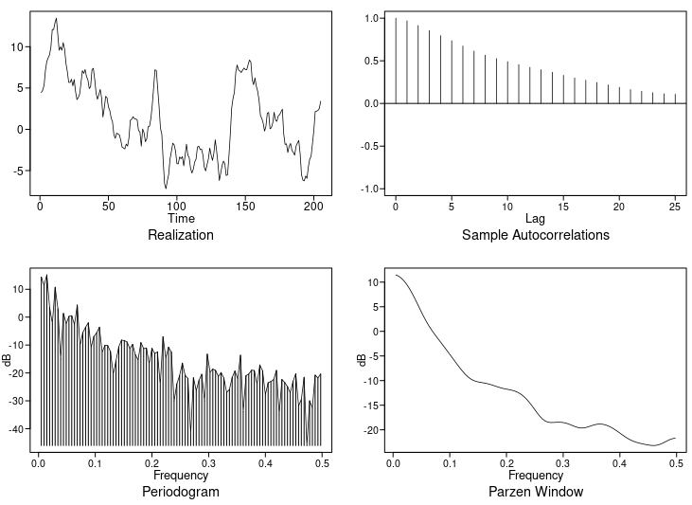
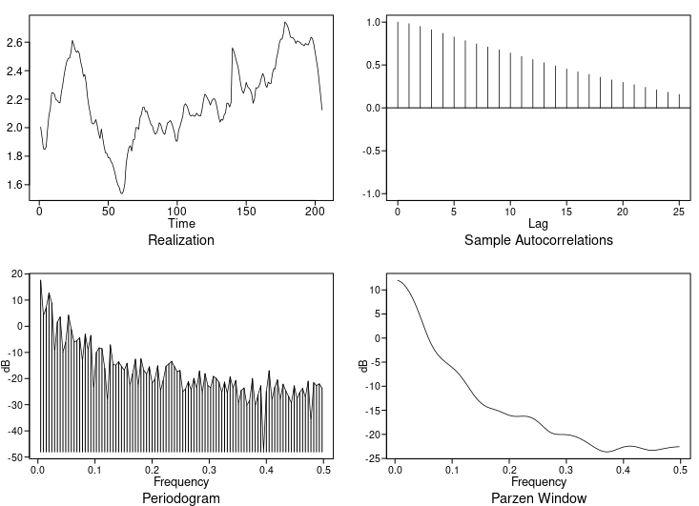
Texas Gas Price MLE
The model plots
The gas price plots
The model is (1-1.38B +0.41B²)X_{t} = a_{t}
They have very similar ACF and frequencies.

Slide 3

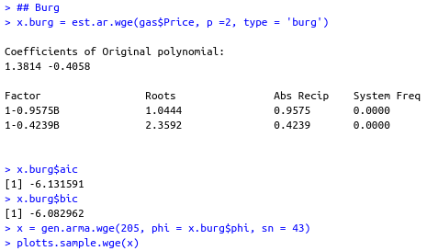
Texas Gas Price Burg
The model plots
The gas price plots
The model is (1-1.38B +0.41B²)X_{t} = a_{t}
They have very similar ACF and frequencies. Burg and MLE has same result

Slide 4
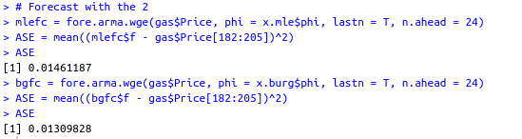
ASE for last 24
The ASE for both are the same. This makes sense because they both generated almost the same phi values. The forecast was also very similar.
I will choose either but given that burg is more efficient and fast, I will lean towards it.

Slide 5
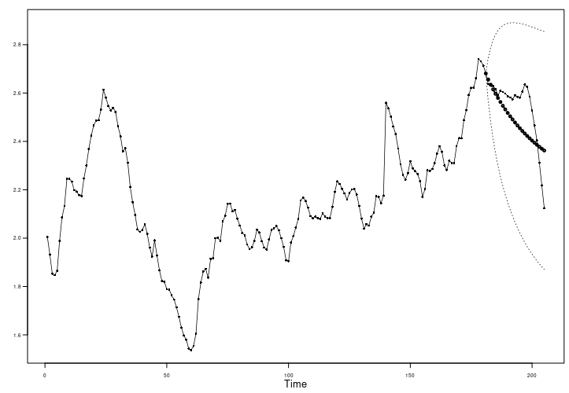
MLE Forecast

Slide 6
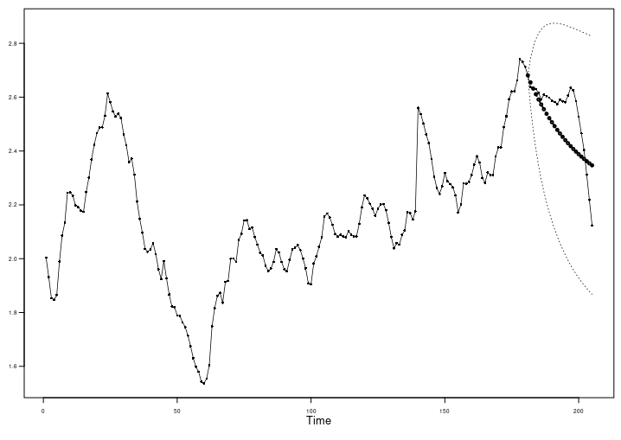
Burg Forecast

Slide 7
Takeaways
The functions est.arma.wge and est.ar.wge are for finding stationary model when you know p and q.
For ARMA models with q > 0, we will always find ML Estimates using est.arma.wge. This technique are computationally intensive in the ARMA and AR setting and must be found iteratively.
Sometimes est.arma.wge may find models with roots inside the unit circle. These models shouldn’t be used as final models.
We have 2 choices for AR models estimation
  ML: as stated above computationally intensive. It has the best mathematical properties but may sometimes find models with roots inside the unit circle.
  Burg: This is fast and non iterative in nature. It will always find stationary AR model. Preferable to next one Yule Walker.
  Yule Walker: This is also fast and non-iterative in nature and will always find stationary AR model, however it shouldn’t be used due to limitations when roots are close to the unit circle.
Estimating p and q for ARMA model is called model identification AIC- type model identification is recommended when identifying the best model to use. There is one called Box-Jenkins which isn’t recommended.

